Slide 1
HTML Introduction

Slide 2
Html
HTML is the standard markup language for creating Web pages.
HTML stands for Hyper Text Markup Language
HTML describes the structure of Web pages using markup
HTML elements are the building blocks of HTML pages
HTML elements are represented by tags
HTML tags label pieces of content such as "heading", "paragraph", "table", and so on
Browsers do not display the HTML tags, but use them to render the content of the page

Slide 3
A Simple HTML Document
<!DOCTYPE html> <html> <head> <title>Page Title</title> </head> <body> <h1>My First Heading</h1> <p>My first paragraph.</p> </body> </html>

Slide 4
Example Explained
The <!DOCTYPE html> declaration defines this document to be HTML5
The <html> element is the root element of an HTML page
The <head> element contains meta information about the document
The <title> element specifies a title for the document
The <body> element contains the visible page content
The <h1> element defines a large heading
The <p> element defines a paragraph

Slide 5
HTML Tags
HTML tags are element names surrounded by angle brackets:
<tagname>content goes here...</tagname>
HTML tags normally come in pairs like <p> and </p>
The first tag in a pair is the start tag, the second tag is the end tag
The end tag is written like the start tag, but with a forward slash(/) inserted before the tag name

Slide 6
Web Browsers
The purpose of a web browser (Chrome, IE, Firefox, Safari) is to read HTML documents and display them.
The browser does not display the HTML tags, but uses them to determine how to display the document:

Slide 7
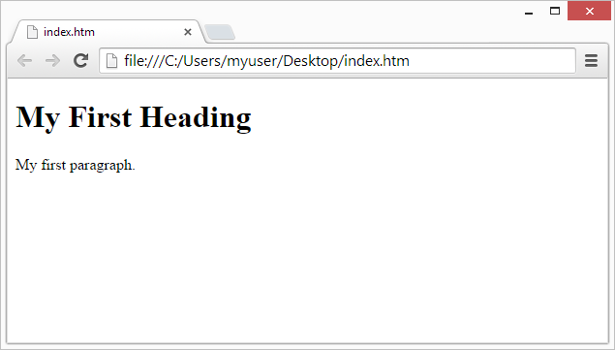

Slide 8
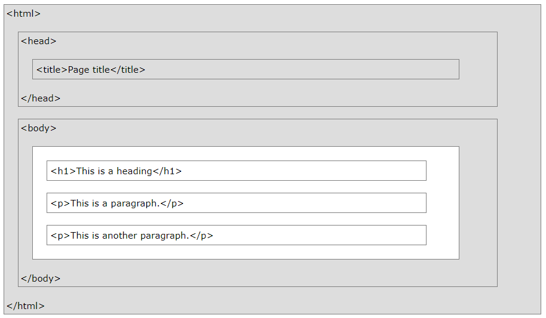
HTML Page Structure
Below is a visualization of an HTML page structure:

Slide 9
The <!DOCTYPE> Declaration
The <!DOCTYPE> declaration represents the document type, and helps browsers to display web pages correctly.
It must only appear once, at the top of the page (before any HTML tags).
The <!DOCTYPE> declaration is not case sensitive.
The <!DOCTYPE> declaration for HTML5 is:
<!DOCTYPE html>

Slide 10
HTML Versions
Version | Year
HTML | 1991
HTML 2.0 | 1995
HTML 3.2 | 1997
HTML 4.01 | 1999
XHTML | 2000
HTML5 | 2014

Slide 11
HTML Editors
Write HTML Using Notepad or TextEdit
Web pages can be created and modified by using professional HTML editors.
However, for learning HTML we recommend a simple text editor like Notepad (PC) or TextEdit (Mac).
We believe using a simple text editor is a good way to learn HTML.
Follow the four steps below to create your first web page with Notepad or TextEdit.

Slide 12
Step 1: Open Notepad (PC)
Windows 8 or later:
Open the Start Screen (the window symbol at the bottom left on your screen). Type Notepad.
Windows 7 or earlier:
Open Start > Programs > Accessories > Notepad

Slide 13
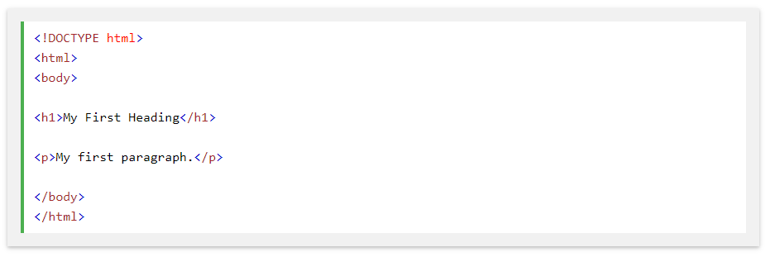
Step 2: Write Some HTML
Write or copy some HTML into Notepad.

Slide 14
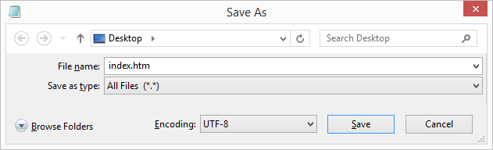
Step 3: Save the HTML Page
Save the file on your computer. Select File > Save as in the Notepad menu.
Name the file "index.htm" and set the encoding to UTF-8 (which is the preferred encoding for HTML files).

Slide 15
Step 4: View the HTML Page in Your Browser
Open the saved HTML file in your favorite browser (double click on the file, or right-click - and choose "Open with").
The result will look much like this:

Slide 16
UTF-8
A character in UTF8 can be from 1 to 4 bytes long. UTF-8 can represent any character in the Unicode standard. UTF-8 is backwards compatible with ASCII. UTF-8 is the preferred encoding for e-mail and web pages

